Slide 1
Bot Sensing Simulator: Raspbian OS
Daniel Foster and Vahe Ohanian

Slide 2
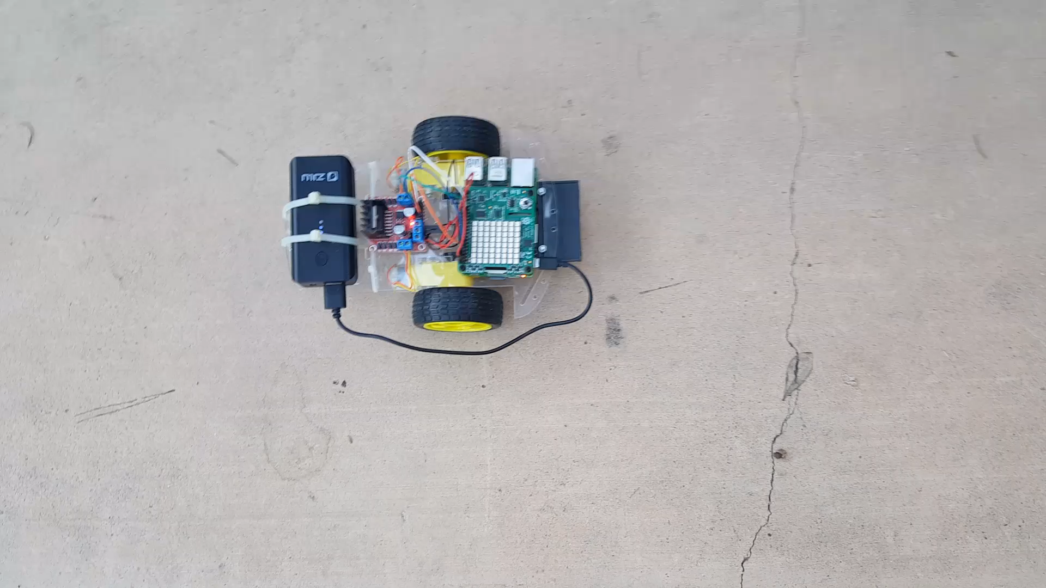
Video Demonstration

Slide 3
Test Cases and Results – Priority Levels
 | Task Names
Priority Settings | Forward Movement | Backward Movement | Right Movement | Left Movement | Bot Stop | Get Temp | Get Hum | Display Temp | Display Hum
Priority Test 1 | 3 | 4 | 7 | 5 | 6 | 2 | 3 | 1 | 1
Priority Test 2 | 5 | 3 | 6 | 7 | 4 | 2 | 3 | 1 | 1
Priority Test 3 | 4 | 5 | 3 | 6 | 7 | 3 | 2 | 1 | 1
Priority Test 4 | 6 | 7 | 4 | 3 | 5 | 3 | 2 | 1 | 1
Priority Test 5 | 7 | 6 | 5 | 4 | 3 | 2 | 3 | 1 | 1

Slide 4
Milestones
Task Number | Description | Delivery Date | Met? | Completed By | Notes
0 | Submit project proposal | September 25th, 2017 | Yes | Joint | -
1 | Obtain hardware/software components (shipping) | October 1st, 2017 | Yes | Vahe | -
2 | Assemble bot components and research necessary hardware components | October 11th, 2017 | Yes | Dan | -
3 | Set-up Raspberry Pi 3 Model B, configure/install Raspbian OS | October 11th, 2017 | Yes | Dan | -
4 | Raspberry Pi Sense Hat implementation/interfacing | October 16th, 2017 | Yes | Vahe | -
5 | Implement sensing module (ex. light sensitivity) | October 18th, 2017 | Yes | Vahe | -
6 | Start research and modification of Raspbian OS, look at scheduling and task management as it relates to our system, implement simple bot movement | October 25th, 2017 | Yes | Dan | -
7 | Prepare progress report and sample demo | October 30th, 2017 | Yes | Joint | -
8 | Implement remaining sensor modules (ex. gyroscope, temperature, etc.) | November 13th, 2017 | Yes | Dan | -
9 | Modify Raspbian OS for maximum optimization of our project and confirm working bot sensing system | November 29th, 2017 | Yes | Vahe | Priority levels implemented in project code (OS settings not modified)
10 | Test using practical mock environments and collect data | December 6th, 2017 | Yes | Joint | -
11 | Prepare final report and presentation, demo working system with at least 2 unique sensors | December 11th, 2017 | Yes | Joint | -
Temperature and humidity used for sensing.
Python scheduler used for task optimization.

Slide 5
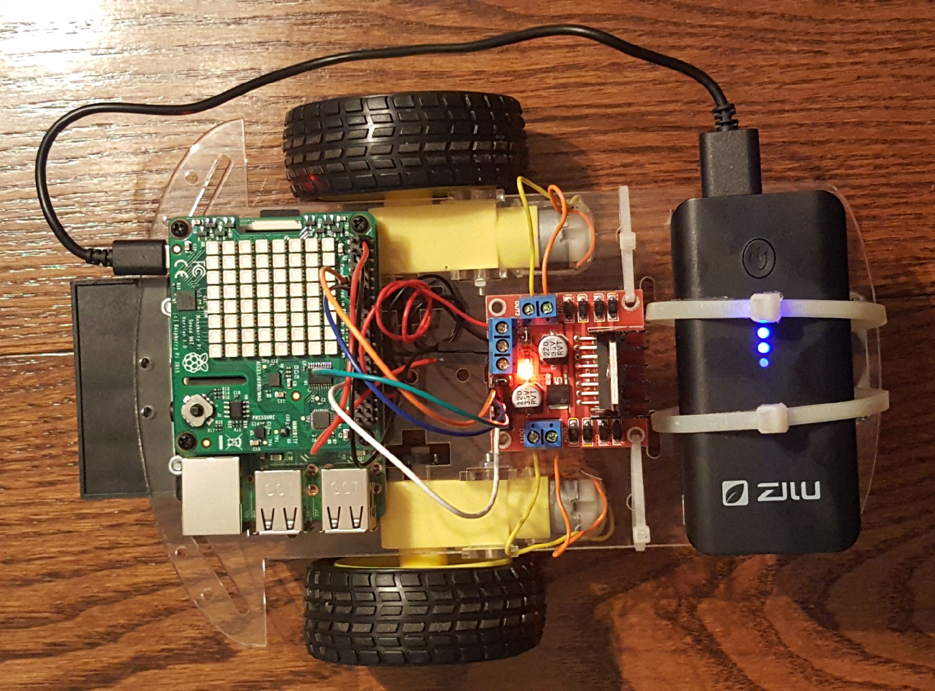
Questions?

